Slide 1

Pipe Overflow Prediction Model in Stormwater Networks and Visualization Using Mixed Reality
SeyedMojtaba Noghabaei
North Carolina State University

Slide 2

Outline
Introduction
Background and Objective Statement
Observed problems
Research Objective
Methodology
Proposed solution
Results and Discussion

Slide 3
Definition of Smart Cities and Application Area
A smart city is an urban area that uses different types of electronic data collection sensors to supply information which is used to manage assets and resources efficiently.

Slide 4
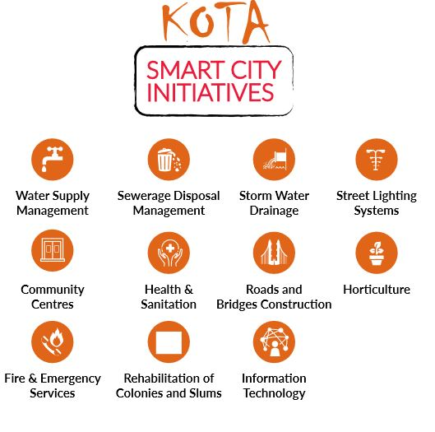
Definition of Smart Cities and Application Area
Data from devices
Data from citizens
Data from assets
Data processing

Slide 5
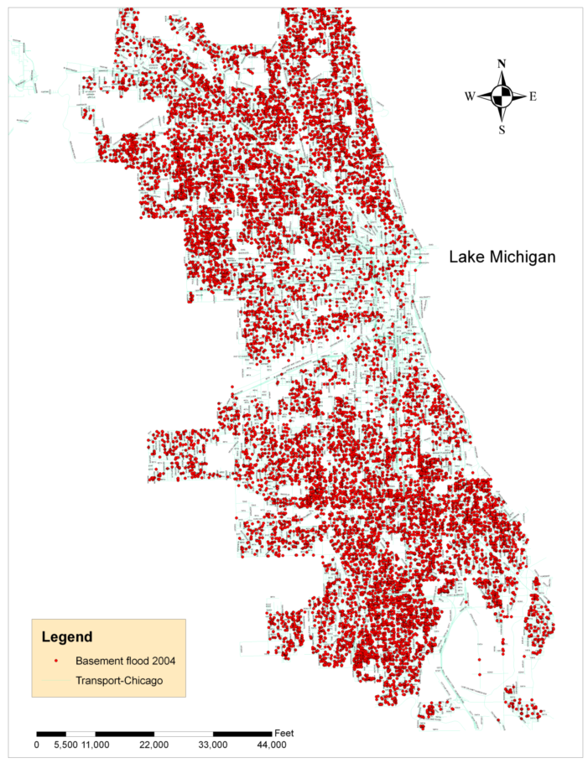
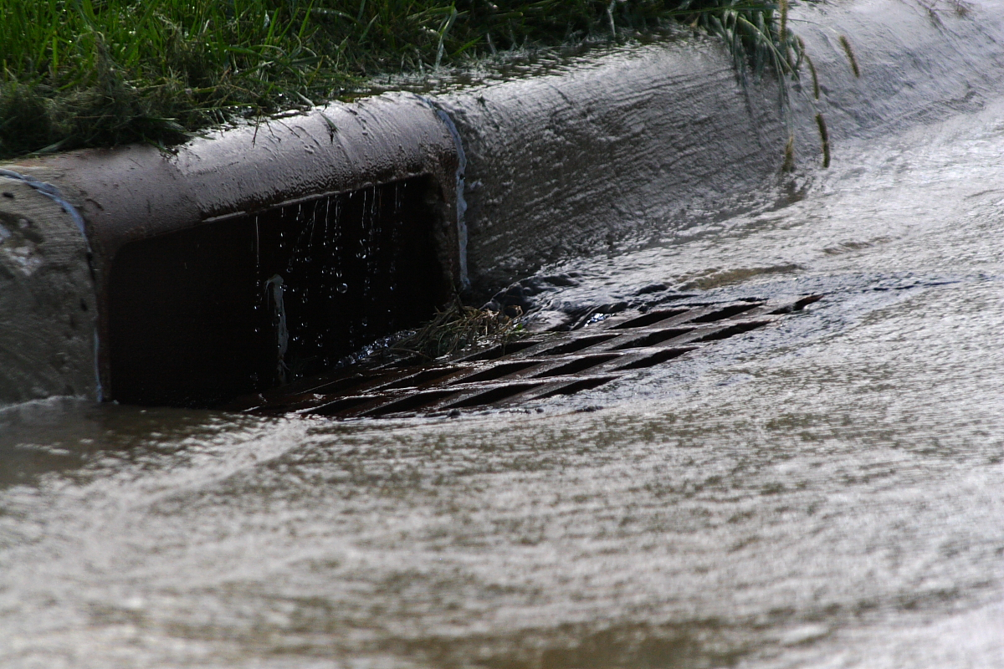
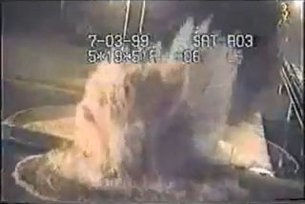

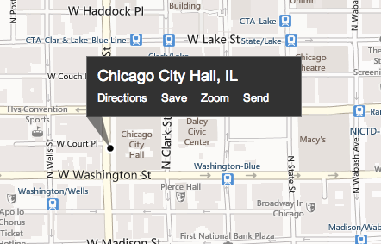
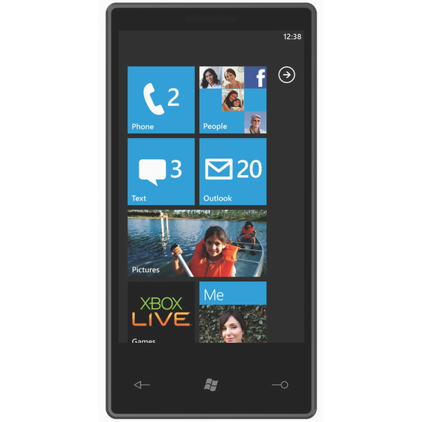
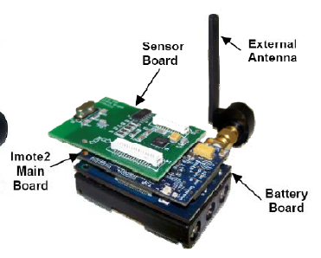

Observed Problems
Overflow in stormwater networks
Drainage
Overflow
Stormwater flow monitoring via low-cost sensor networks and social networking.

Slide 6
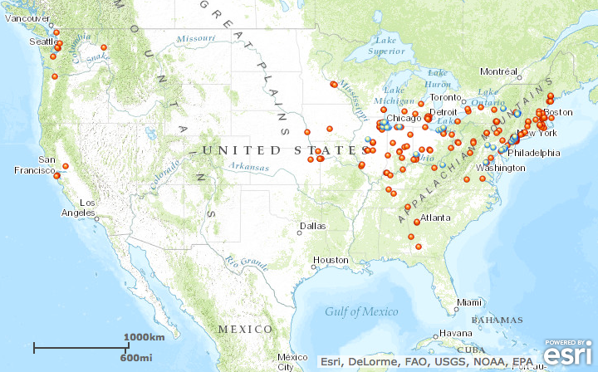
Observed Problems
Water Problems Elsewhere
Is it possible to predict overflows?

Slide 7
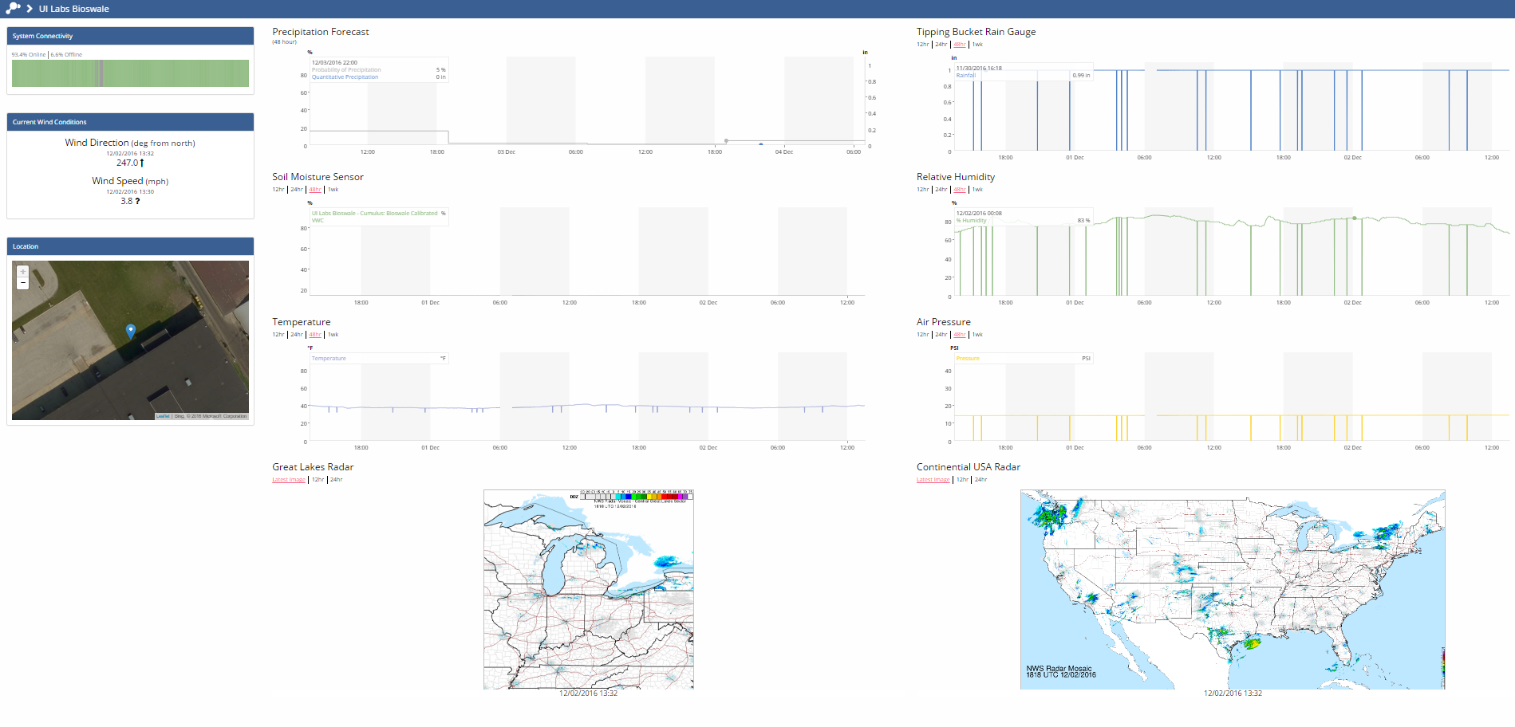
Visualization and Sense-Making
Current visualization approaches for smart cities data
Notes:
Best decisions
Allocating resources during a disaster

Slide 8
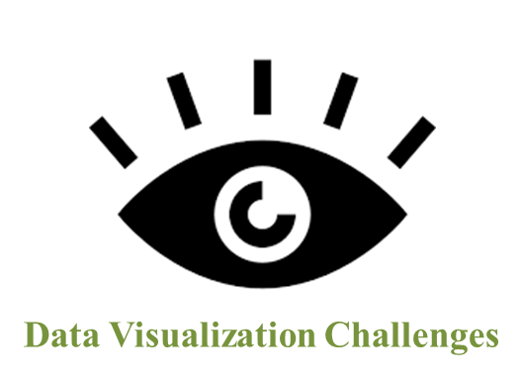
Data Visualization Challenges
1. Limited field of view of objects
3. Lack of real-time data dissemination
2. Lack of features enabling collaboration
Notes:
1. Multidimensional data (e.g., vehicular traffic data) cannot be probed effectively from different aspects (such as "when was traffic data highest" or "How is it related to weather?,"etc.) on a flat screen. To understand their different relations with other data, you need to run analysis multiple times. You, often, forget the previous relations or you do not get a complete picture of a situation simultaneously.
2. The current analysis and visualization platforms do encourage collaboration as
stakeholders from different departments such as water and waste management departments
from remote locations cannot see and interact the same data simultaneously.
Today, cities move by data. Government agencies prevent unwanted incidents, warns
citizens beforehand any eventualities and protect them using real-time data insights.
Any inefficiencies to handle data not only make the smart cities ineffective but also
pose severe risks to citizens’ lives.
3. Imagine there is a leakage with a pipeline at some point. A new engineer goes there and want
to dig the ground. He must rely on a 2D static map without any detailed information of
equipment installed underneath. He needs to rely on voice-based
Instructions from his senior . Though the sensor captures all information about the pipeline, the current platform fails to disseminate critical information to remote workers.

Slide 9

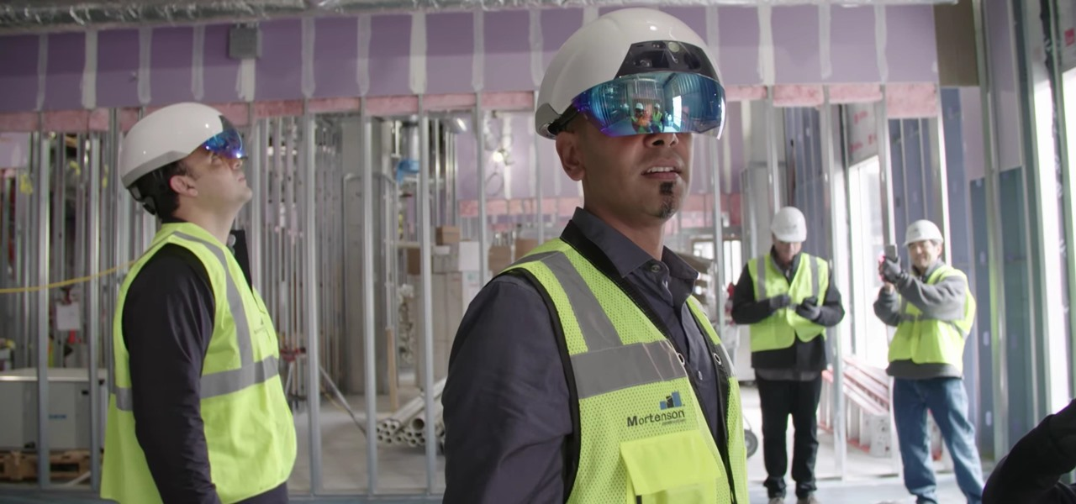
Data Visualization Challenges
Smart visualization is the First step toward becoming a truly smart city*
*Jan-Philipp Mohr(2017) “IMMERSIVE DATA VISUALIZATION FOR SMART CITIES”
Notes:
One of the things that we can use is MR technology

Slide 10


Why Mixed Reality?
Why Mixed Reality?
Helps for better actions and decisions
When we see things we make progress
Allow to live experience in augmented and virtual environments
These technologies are looking forward to minimize the labor and cost.
Notes:
We understood that visualization is important, but why MR ?

Slide 11
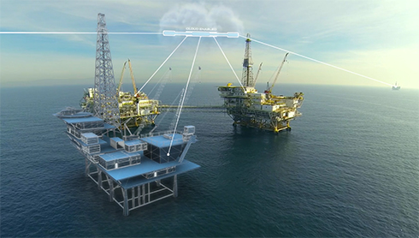
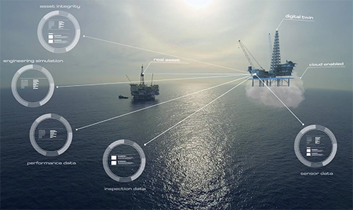
Why Mixed Reality?
Notes:
We understood that visualization is important, but why MR ?

Slide 12

Why Mixed Reality?
AR/VR/MR offer large possibilities to visualize complex urban systems, to live and share urban experience, to create emotional environment, to learn, to understand, to act together for the city.

Slide 13
Research Objectives
Create a platform to predict overflows in order to help utility managers before disasters.
Create a digital twin for the stormwater network and enable utility managers for better decision making using Mixed Reality technology.

Slide 14
Research Method
Data from previous overflows or SWMM
Create models for predicting overflows
Visualize in a twin MR model

Slide 15
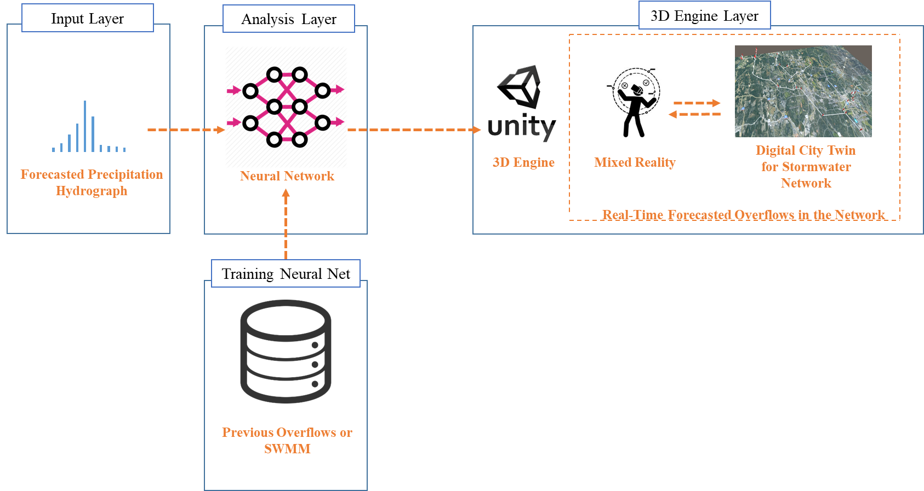
System Architecture

Slide 16
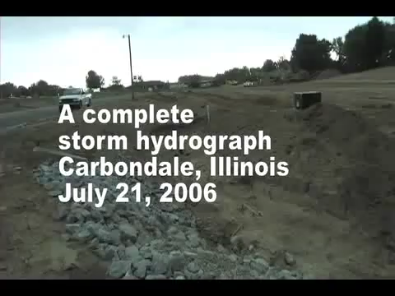
Which Precipitations Cause Overflow Problems
Notes:
40 Seconds

Slide 17
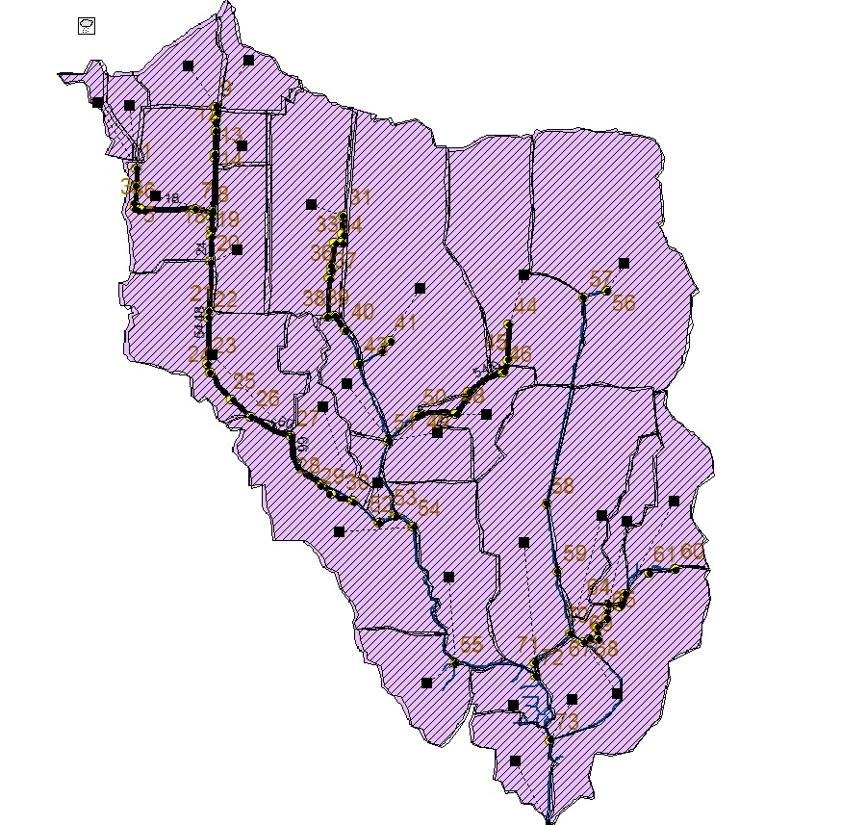
Training Data
Run SWMM for 150 of different precipitations and find pipes or junctions with overflow problems
5 minute sampling hydrographs
All data is from city of Raleigh

Slide 18
Which Precipitations Cause Overflow Problems
Precipitation hydrograph (5 min sampling)
Precipitations with high peak

Slide 19
Make The Precipitation Shape More Simple
Simplify hydrograph with four numbers
Var. 2
Var. 1
Var. 3
Var. 4 (time)
Notes:
Dimentionality

Slide 20
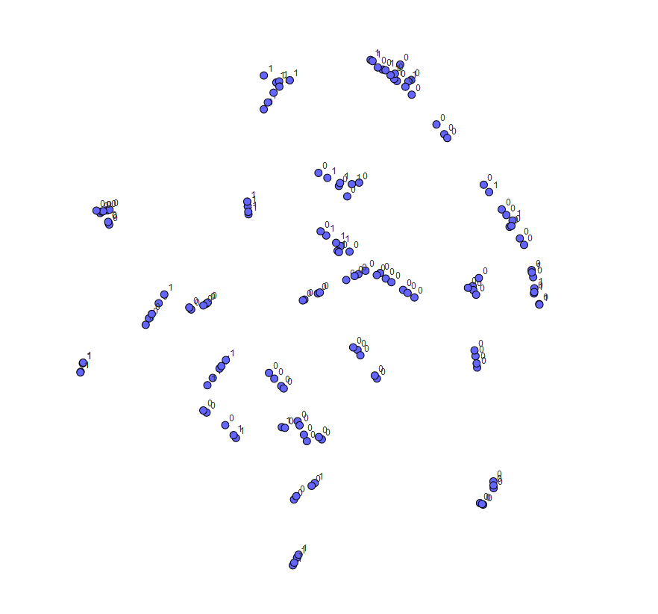
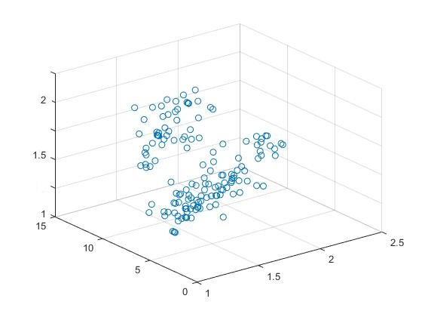
Data
Dataset (150 different hydrographs)
3 factor plotting
t-SNE chart
Notes:
Well distributed

Slide 21
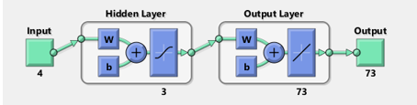
NN Training
Neural net fitting
4 inputs for each hydrograph
3 hidden layers
73 outputs for each junction in network(1 or 0)

Slide 22
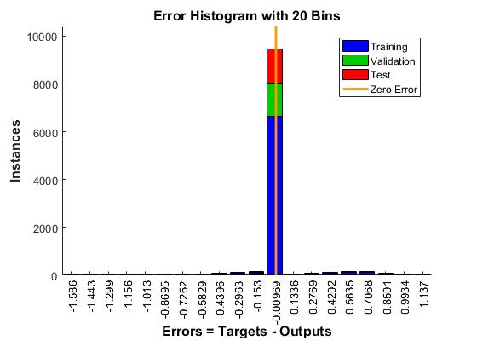
NN Results
70% training
15% validation
15% test

Slide 23
NN Results
MSE = 0.0614
R = 0.863
Mean Squared Error is the average squared difference between outputs and targets. Lower values are better. Zero means no error.
Regression R Values measure the correlation between outputs and targets. An R value of 1 means a close relationship, 0 a random relationship.
Notes:
R-MSE = 0.078 inches

Slide 24
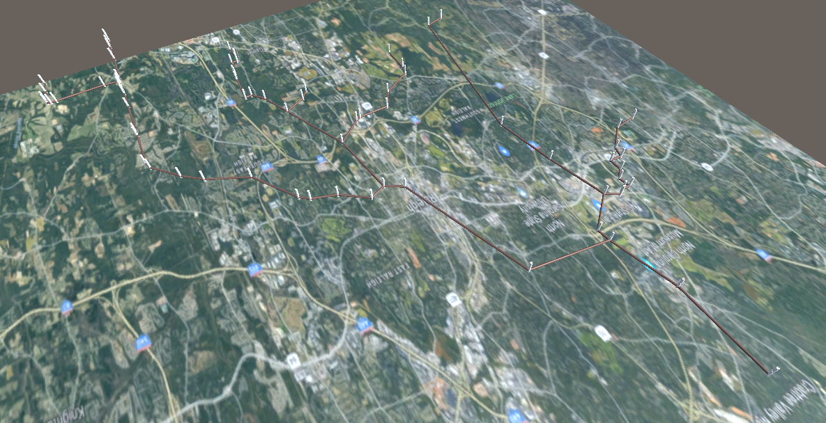
Twin digital model in MR
Water Flow Mapping

Slide 25
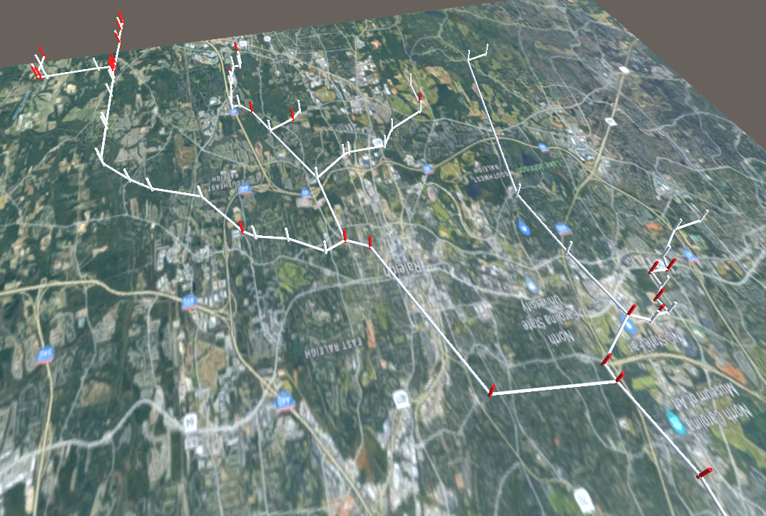
Results
Real-time over flow prediction platform
Test a totally new sample with just one misclassification
Neural Net
Forecasted hydrograph
Predicted overflow pipes in MR environment

Slide 26
Results
Is it possible to predict overflows?
The results of this study shows how we can use data collected by sensors to improve management and predict overflows.

Slide 27
Discussion and Vision
Efficient stormwater management
Rapid and ahead of time response in emergencies
Efficient disaster management
We can use this approach in other areas smart cities like traffic, water network, and natural gas network.

Slide 28
Limitation
It is a predicted model and cannot detect issues caused by extraordinary events
How we can use our resource in an optimal way?

Slide 29
Conclusion
The problem was predict overflow and visualize it in a better way
We used different types of neural networks and tested them and reported the best one
Finally we were able to train a neural network model using our data and predict overflow and visualize it in a digital twin model of network

Slide 30
Thank You

Slide 32
